Slide 1
Sentiment Analysis of YouTube Comments
2410030138 -K.Gowtham
2410030188 -Anish Jadhav
2410030320 -V.Mukesh
2410030250 -G.Kishore
2410030496 -P.Karthikeyan

Slide 2
Developed Methodology
All duplicates, stopwords, unnecessary characters, and unwanted text patterns are removed systematically for improving data quality.
The project is based on real YouTube comments which are short, informal, and noisy, making the analysis more practical and closer to real-world scenarios.
The sentiments are clearly categorized into three meaningful classes: Positive, Negative, and Neutral, ensuring easier interpretation.

Slide 3
Methodology Evaluation
The dataset has real YouTube comments, so it is practical and realistic.
Preprocessing cleaned the text properly by removing noise like stopwords, punctuation, and extra spaces.
The classification model divided comments into Positive, Negative, and Neutral correctly.
Visualizations made the results easy to understand for everyone.
The method is simple, less complex, and can be applied to other datasets too.
It is beginner-friendly and useful for students to learn basics of data analysis.

Slide 4
Data Preprocessing
Converted all comments into lowercase for uniformity.
Removed punctuation, numbers, and special characters.
Removed common stopwords like is, the, at, of, on.
Normalized extra spaces to make text clean.
Stored the cleaned version of comments in a new column cleaned_comment.

Slide 5
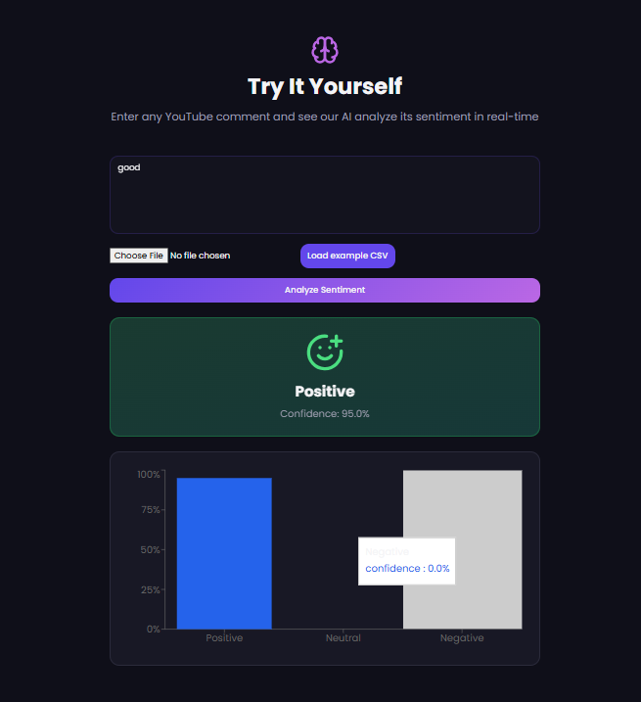
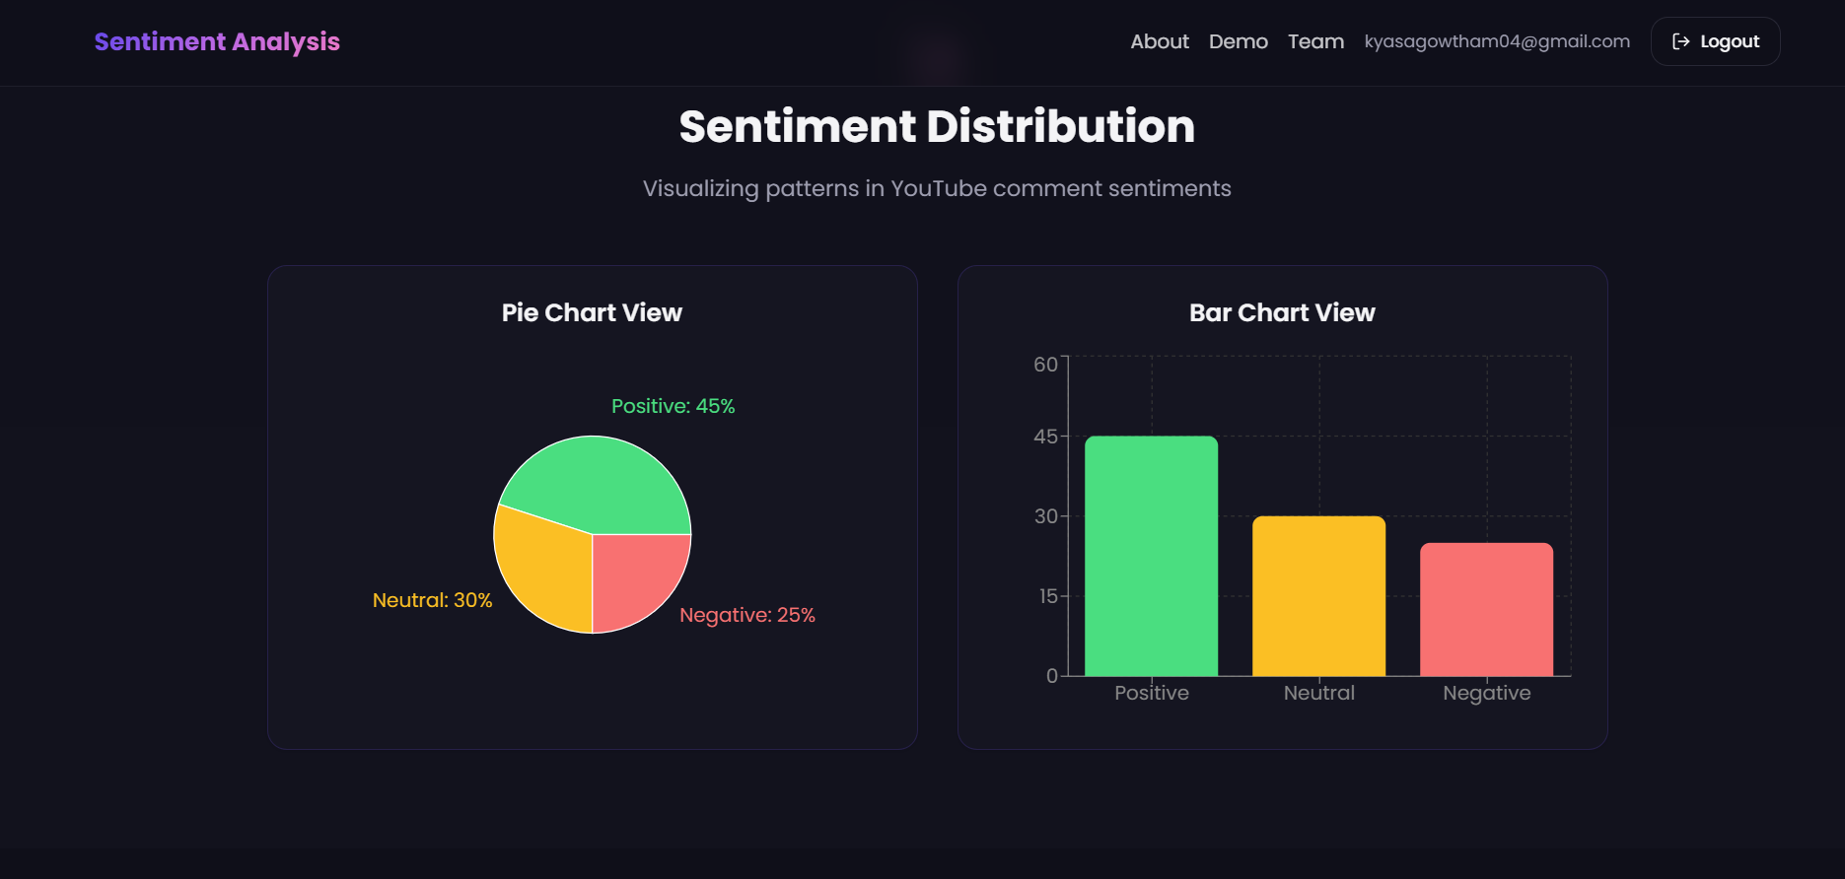
OUTPUT

Slide 6
THANK YOU

